Slide 1

Software Requirements

Slide 2
Iterative Development Process
We are here
Analysis
Design
Implementation
Requirements
Planning
Initial Planning
Testing
Evaluation
Deployment

Slide 3
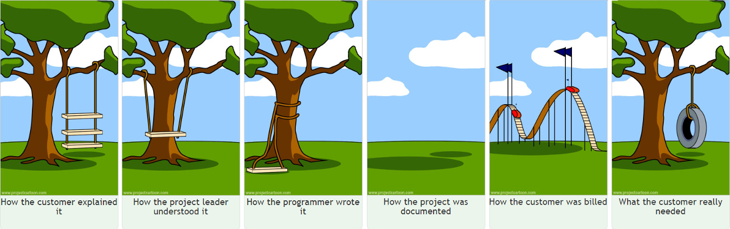

Slide 4
The most important single aspect of software development is to be clear about what you are trying to build.
- Bjarne Stroustrup
Walking on water and developing software from a specification are easy if both are frozen.
- Edward Berard

Slide 5
Problems
Need to figure out what customer wants
Not make false/incorrect assumptions
Need to chunk work into bite-sized pieces
So work can be divided up
So system can be built incrementally
So estimates are remotely accurate

Slide 6
What are software requirements?
Capabilities and conditions to which the system must conform

Slide 7
What are software requirements?
Come in many different flavors
High-level, low-level
User, system
Functional, non-functional
Implementation details

Slide 8
Functional and Non-Functional
Functional
Services the system provides
How the system reacts to inputs
How the system behaves in situations
What the system does not do
Non-functional
Constraints on the services the system provides
E.g., timing, standards, development process
Also known as “solution” and “quality of service” requirements

Slide 9
FURPS+ Classification of Requirements
Functional: features, capabilities, security
Usability: human factors, help, documentation
Reliability: frequency of failure, recoverability, predictability
Performance: response times, throughput, accuracy, availability, resource usage
Supportability: adaptability, maintainability, internationalization, configurability

Slide 10
And here’s the +
Implementation: resource limitations, languages and tools, hardware
Interface: constraints imposed by interfacing with external systems
Operations: system management in its operational setting
Packaging: for example, a physical box
Legal: licensing, etc.

Slide 11
Lists of definitions like this can be a bit tedious (SE is certainly full of them)
Their main benefit is as a checklist, so you don’t forget anything important
It is easy to only care about functionality

Slide 12
Functional requirements
Functional: features, capabilities, security
Usability: human factors, help, documentation
Reliability: frequency of failure, recoverability, predictability
Performance: response times, throughput, accuracy, availability, resource usage
Supportability: adaptability, maintainability, internationalization, configurability
Notes:
Often most attention gets put here and non-functional are fogotten

Slide 13
Non-functional
Functional: features, capabilities, security
Usability: human factors, help, documentation
Reliability: frequency of failure, recoverability, predictability
Performance: response times, throughput, accuracy, availability, resource usage
Supportability: adaptability, maintainability, internationalization, configurability

Slide 14
Lets try it!
List out a few bullets for each…
Functional: features, capabilities, security
Usability: human factors, help, documentation
Reliability: frequency of failure, recoverability, predictability
Performance: response times, throughput, accuracy, availability, resource usage
Supportability: adaptability, maintainability, internationalization, configurability

Slide 15
Ok, so lets look at ways to gather and manage requirements

Slide 16
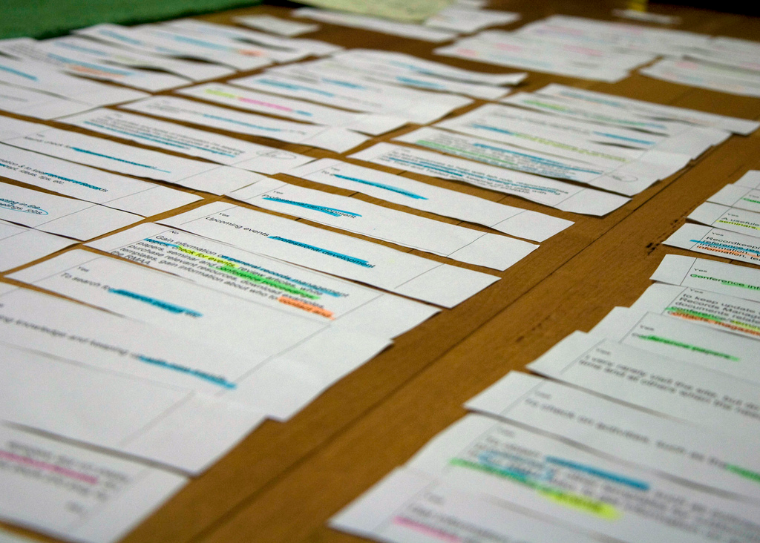
User stories (USs)
“Plan using units of customer-visible functionality.”
http://flic.kr/p/884GBP
Notes:
Quote from Kent Beck’s Extreme Programming Explained (2005).

Slide 17
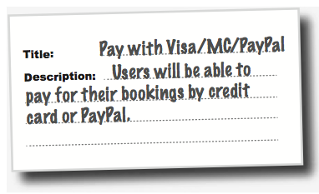
Flight-Booking System Example

Slide 18
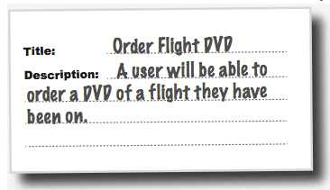
Flight-Booking System Example

Slide 19
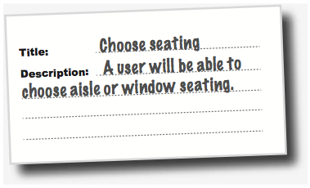
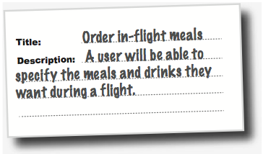
Flight-Booking System Example
Two parts: title and description

Slide 20
User Story Dos and Don’ts
USs should …
USs should not …
describe one thing that the software needs to do for the customer
be written using language that the customer understands
be written by the customer (figuratively speaking)
be short. Aim for no more than three sentences
be a long essay
use technical terms that are unfamiliar to the customer
mention specific technologies
mention implementation details
Principle: Keep requirements customer-oriented

Slide 21
Helpful US-Description Template
Template: “As a <who>, I want <what> <why>.”
Can be rearranged as long as it includes who, what, why
Example: “As a dog, I want to order food online, so I don’t have to rely on people anymore.”
“Why” is sometimes optional, but helpful
Don’t be afraid to have multiple whos, each with their own why
Who: user, admin, car buyer, car seller

Slide 22
US-Description Examples: Who and What

Slide 23
Helpful US-Title Template: Verb + Noun

Slide 24
Let’s write some user stories!
Title: <verb> <noun>
Description: As a <who>, I want <what> <why>.

Slide 25
Other ways to write requirements…

Slide 26
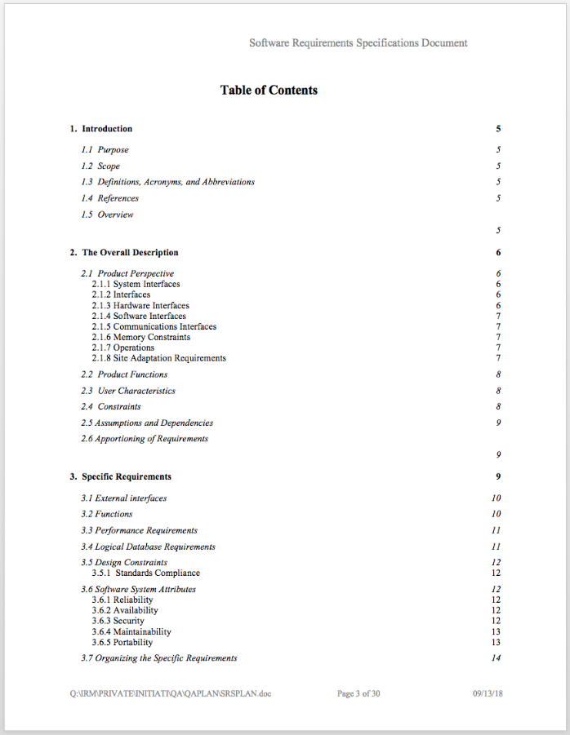
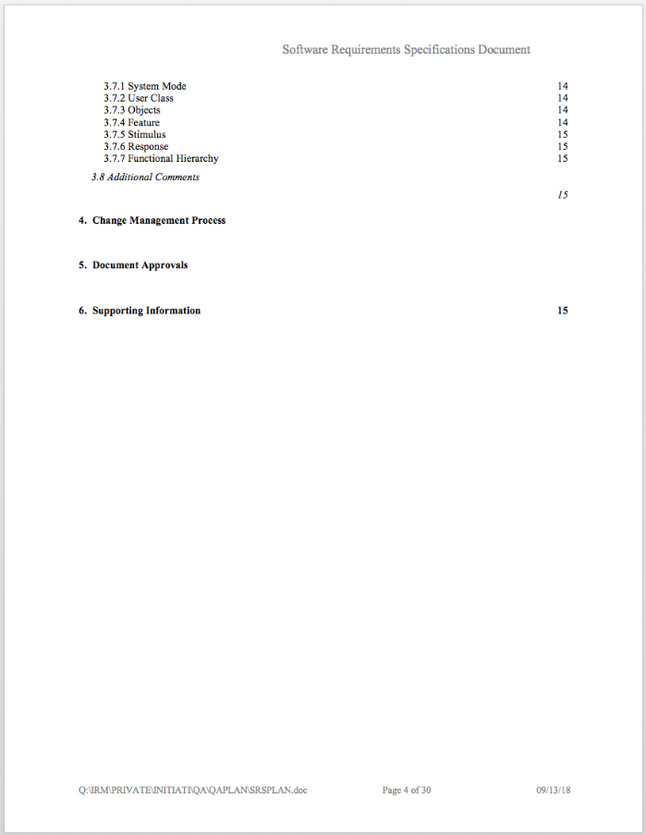
Software Requirements Specification (SRS)
IEEE Std 830-1993
Very formal, very long… template is 30 pages!
Won’t be covering it, just be aware of its existence

Slide 27
Unified Modeling Language
Won’t be studying this either (you’re welcome!)
Used to be “popular”, still used somewhere

Slide 28
Use Cases
Text stories of an actor using a system to meet goals
Can be either formal/structured or informal

Slide 29
Example: Processing a sale at a grocery store
Process Sale: A customer arrives at a checkout counter. The cashier uses the POS system to record each purchased item. The system presents a running total and line-item details. The customer enters payment information, which the system validates and records. The system updates inventory. The customer receives a receipt from the system and then leaves with the items.

Slide 30
Actor: something with behavior, such as a person, computer, organization
Scenario: specific sequence of actions and interactions between actors and the system
Use case: collection of related success and failure scenarios that describe an actor using a system to support a goal

Slide 31
Example: Processing a sale at a grocery store
Process Sale:
Main success scenario: A customer arrives at a checkout counter. The cashier uses the POS system to record each purchased item. The system presents a running total and line-item details. The customer enters payment information, which the system validates and records. The system updates inventory. The customer receives a receipt from the system and then leaves with the items.
Alternative scenarios:
If the customer paid by credit, and the reimbursement transaction to their credit account is rejected, inform the customer and pay them with cash.
If the item identifier is not found in the system, notify the cashier and suggest manual entry of the identifier code (perhaps it is corrupted).
If the system detects failure to communicate with the external accounting system…

Slide 32
Example: Processing a sale at a grocery store
Process Sale:
Main success scenario: A customer arrives at a checkout counter. The cashier uses the POS system to record each purchased item. The system presents a running total and line-item details. The customer enters payment information, which the system validates and records. The system updates inventory. The customer receives a receipt from the system and then leaves with the items.
Preconditions:
Cashier is identified and authenticated
Customer has nonzero items
Alternative scenarios:
If the customer paid by credit, and the reimbursement transaction to their credit account is rejected, inform the customer and pay them with cash.
If the item identifier is not found in the system, notify the cashier and suggest manual entry of the identifier code (perhaps it is corrupted).
If the system detects failure to communicate with the external accounting system…

Slide 33
Structure of a Use Case
Preconditions
Assumptions for a Use Case to happen
Avoid obvious ones… user is alive, computer is plugged in
Main success scenario
Story of a user achieving a goal using a system
Alternative scenarios
Things that could go wrong
Other choices the user could make
E.g., customer doesn’t want an item at checkout
E.g., credit card is rejected

Slide 34
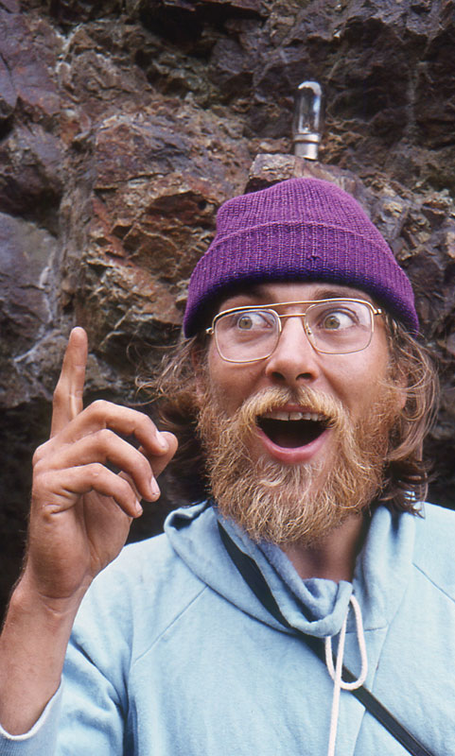
Why create use cases?
Easy to understand/contribute
Help communication
Emphasize user goals
Keep the requirements focused on the customer
Avoid working on tasks with no use case
Identify unthought of features
Aha!
http://flic.kr/p/5dFxK2

Slide 35
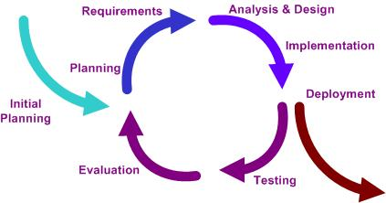
Which UCs to write/refine first?
High value
I.e.: Represent system’s core functionality
High risk
Architecturally significant
http://en.wikipedia.org/wiki/File:Iterative_development_model_V2.jpg

Slide 36
User stories, use cases, and issues
How to apply this to your project?
Use US and UC to plan iterations
Break them down into smaller Issues
Aim to complete a US by a specific iteration

